Slide 1
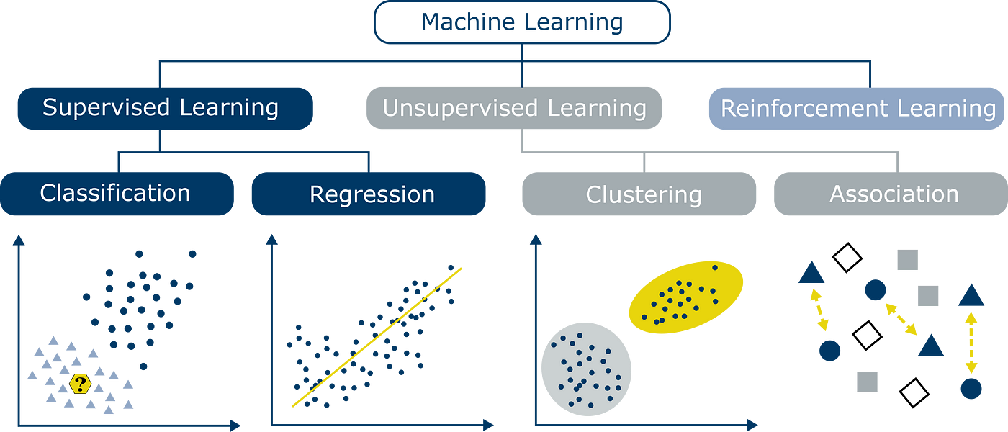
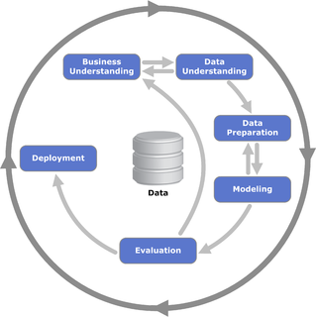
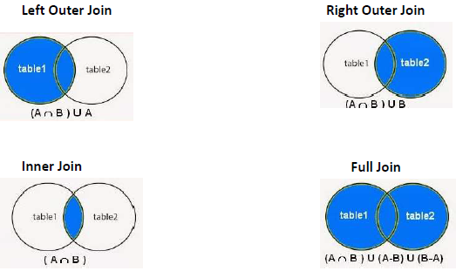
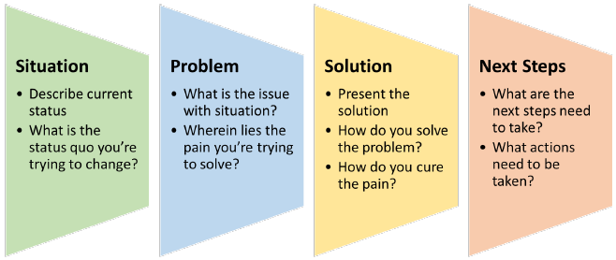
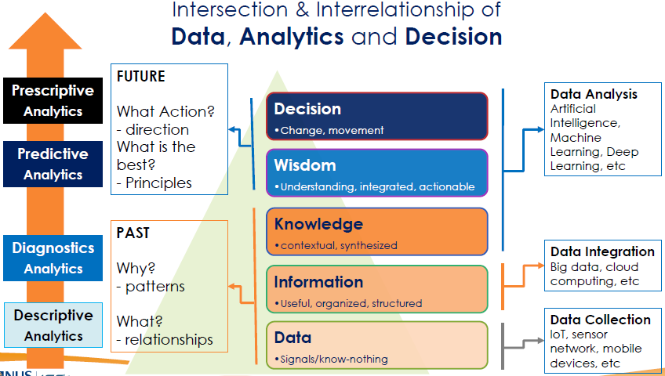
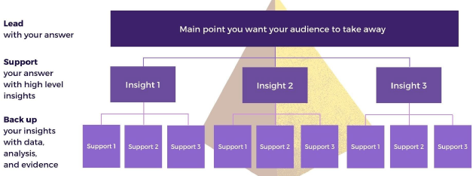
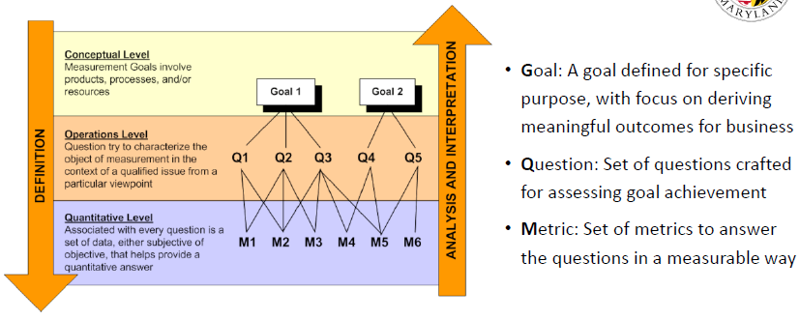
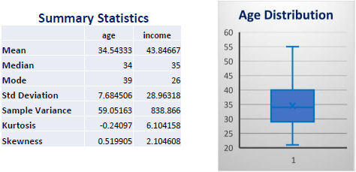
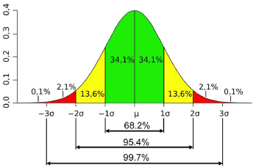
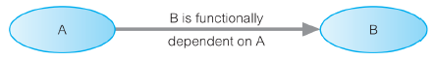
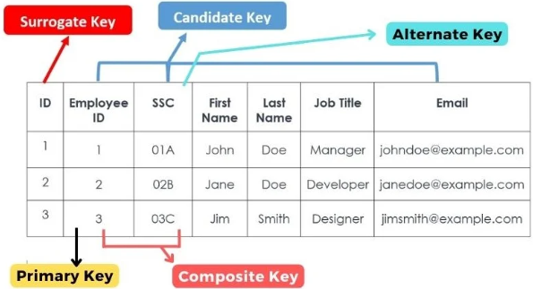
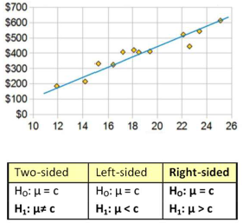
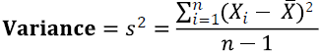
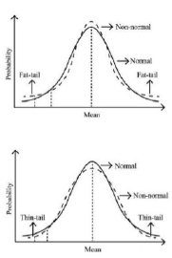
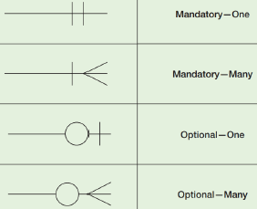
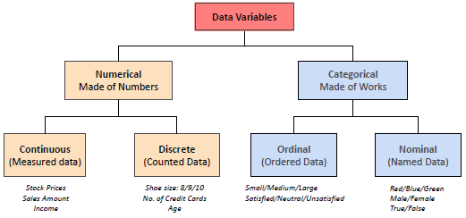
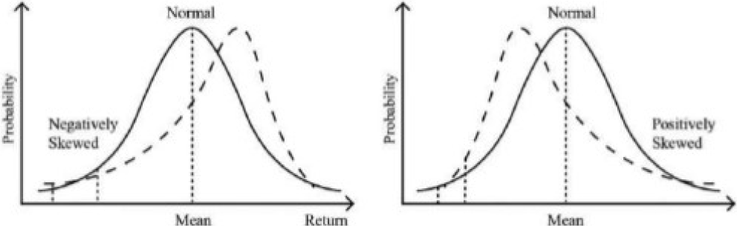
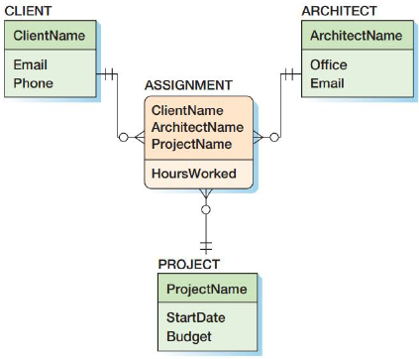
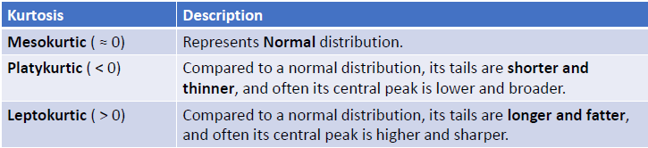
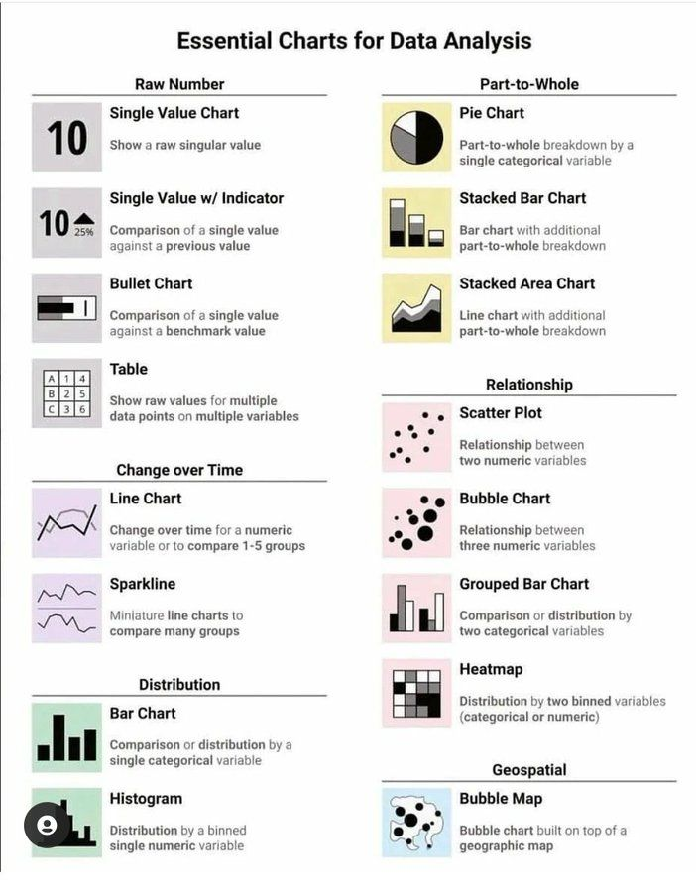
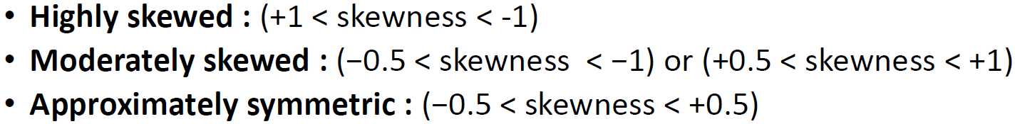
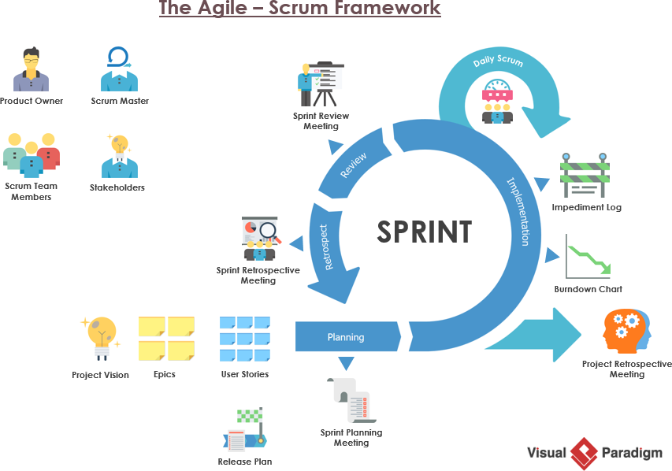
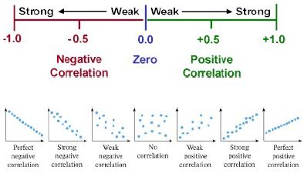
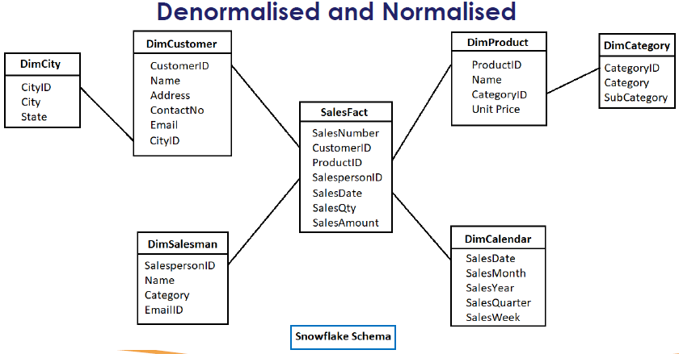
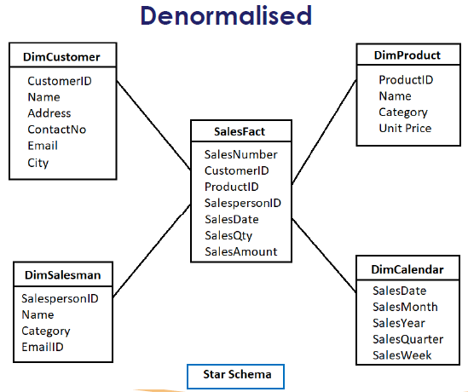


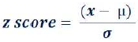
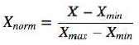
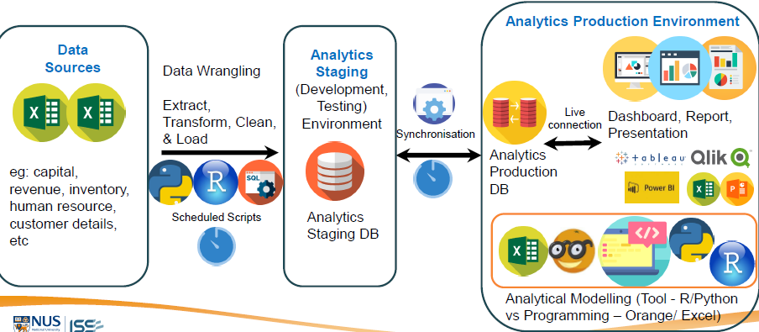
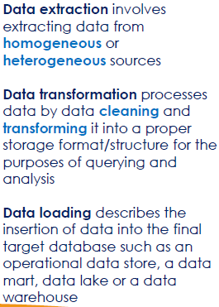
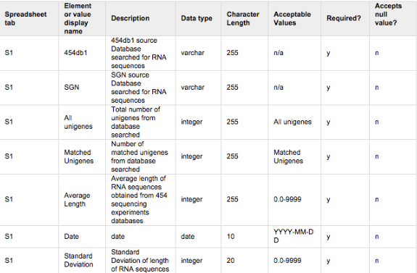
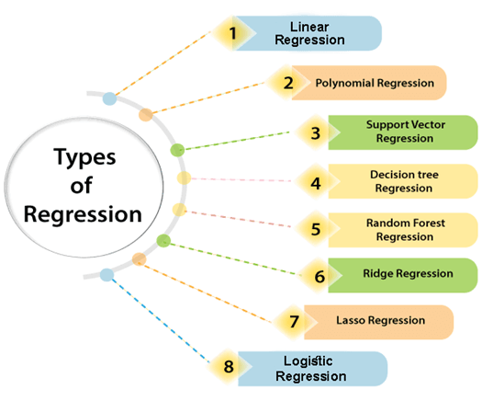
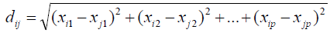
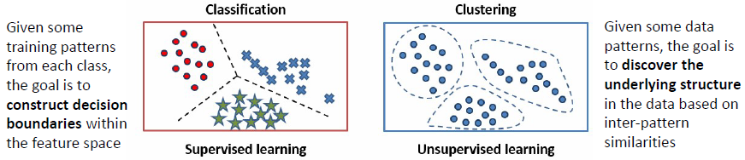
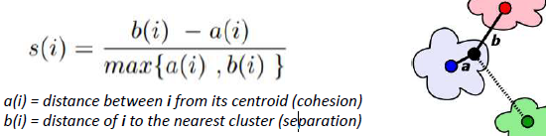
1. Statistics for Business
2. Data Storytelling
3. Data Management for Analytics
Primary
Analyst involved in data collection process
Data collected for specific study
Types of
Join/Merge
SPSN
Minto Pyramid
GQM (Goal Question Metrics)
Data Source
Secondary
Access existing data
Data collected by 3rd party
Data collected not for specific study
Machine Learning
Narrative Structure
developing algorithms and models to learn and analyze from data and make predictions or decisions
Descriptive
Describe data in convenient and informative way
Data summaries and visualization
Central Tendency
Mean (average), influenced by outliers
Median (middle value), less influenced by outliers
Mode (most frequent occurring)
Variability/Spread
Range (total spread)
Variance (how much data deviates from mean value)
Standard Deviation (square root of Variance)
Coefficient of Variance (ratio of SD to Mean)
Shape
Skewness (degree of distortion, lack of symmetry)
Kurtosis (heavy/light-tailed relative to normal distribution)
Functional Dependency (A->B)
Normalization Form
Process of organizing and structuring data in a relational database to eliminate redundancy and improve data integrity (minimize data duplication, efficient data storage and retrieval
0NF
1NF – Repeating groups of nesting in relations
2NF – No Partial functional dependency, attribute dependent on part of key
3NF – No Transitive functional dependency
2 Categories of Statistics
Descriptive Statistic
Measures of…
Full Functional Dependency
A->B
Partial Functional Dependency
A -> C <- B
C partially dependent on both A & B
Transitive Dependency
A->B->C
C is transitively dependent on A
Inferential
Draw conclusions based on sample data
Regression and Hypothesis Tests
Data Modelling
Crow’s Feet
Data Types
Entity Relationship Modelling
OLTP (Transactional Database)
Data Model – Plan or blueprint for database design
Maximum
Minimum
Number of association through a particular relationship
Atomicity – “all or nothing”
Consistency – transform from and to consistent state
Isolation – independent of each other
Durability – Permanence in database record
Cardinality
Properties of
Transaction
Pearson Correlation Coefficient (r)
- Indicates strength of linear relationship between 2 numeric variables
Goodness of Fit Measure (r²)
- Indicates model fit is good or not (r² >0.7 is good model fit)
Linear Regression
Correlation Analysis
Dimensional Modelling
OLAP (Analytical,
Data Warehouse/Data Mart)
Dimension Table
- Normalized
Segment Data
Fact Table
- Denormalized
Overtraining, model becomes too specialized in fitting the training data, resulting in poor performance on new, unseen data (Tree pruning)
Prevent feature domination
Z score
Spurious Correlation
- linear relationship between two variables that do not have any apparent interdependence or association between each other
Normalization
Denormalized for
query performance
Decision Tree
Min-Max scaling
Best split using Node Purity
Data Dictionary
Regression Analysis
- Understand and quantify relationship between dependent variable and one or more independent variable
Group Data
Multivariate data analysis
Unknown categories
Euclidean Distance Measure
Silhouette Coefficient (assess internal cohesion and external separation of clustering solution)
ETL
Extract, Transform, Load
Regression Analysis
Classification
Known categories
Clustering
Relational Database Table – Developed with Entity Relationship Modelling, rows and columns
Data Lake – Repository of large volume of raw unprocessed data from various sources
Data Warehouse – centralized data repository from various sources
Data Mart – Subset of Data Warehouse, focus on specific case or group
Data Fabric – end-to-end data integration and management solution
Data Mesh – decentralization and domain-oriented ownership
Infographic – Graphic format design representation of information/data, easily understandable
De-normalized – Multiple repeating rows
Normalized – Unique rows
K-Clustering, where k is no. of cluster

Slide 2
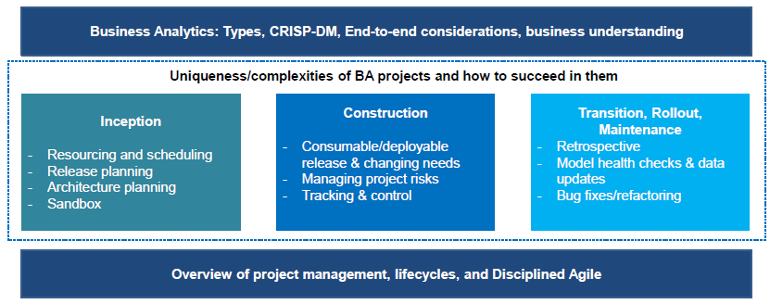
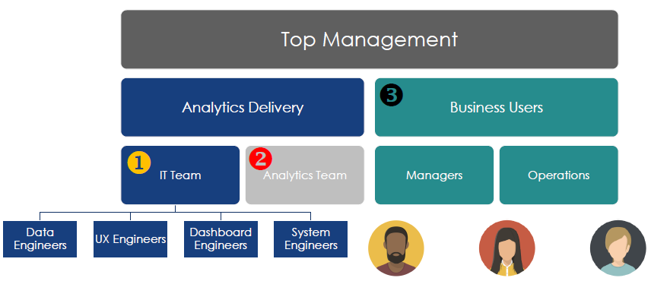
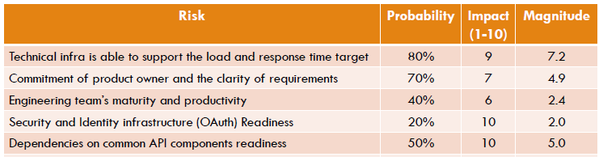
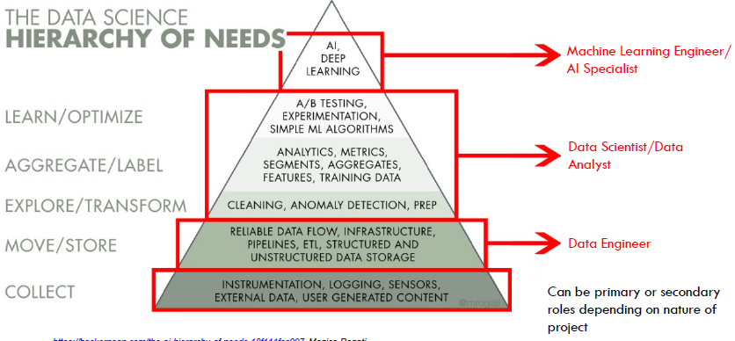
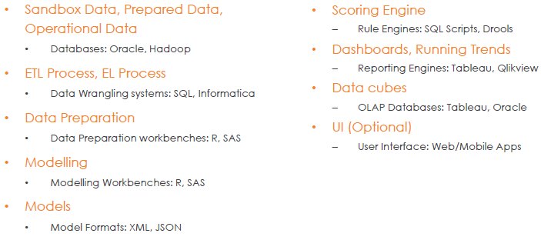
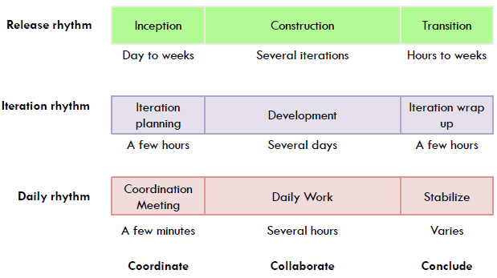
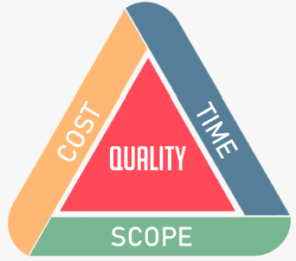
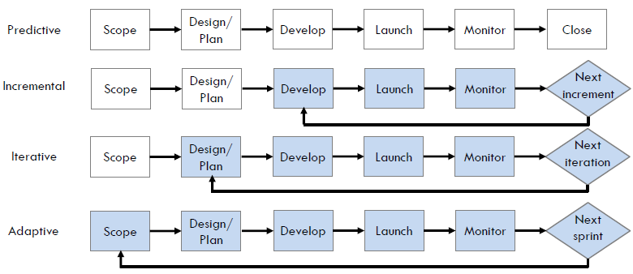
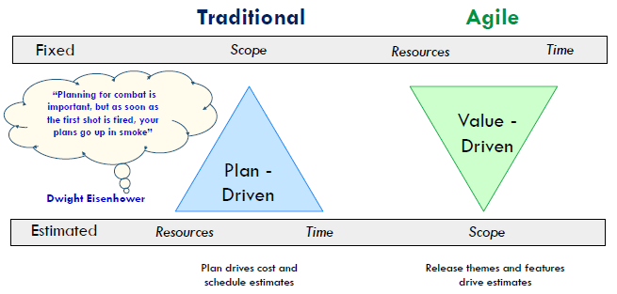
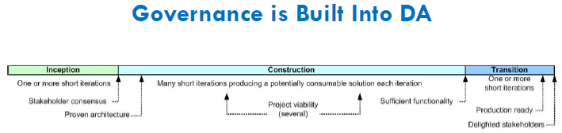
Calculating Risk e.g.
Managing Business Analytics Projects
Stakeholder Perspective
- Ea Stakeholders think differently
- IT
- Analyst
- BU
4 types of Analytics
Descriptive Analytics - summary of past data to understand historical performance and trends
Diagnostic Analytics - understand why those events occurred
Predictive Analytics - forecast future events or trends using historical and current data
Prescriptive Analytics - recommending specific actions or strategies to optimize outcomes
Tools required at ea stage
← Inception Phase
Project Management Triangle
Project Lifecycle
- Predictive (aka waterfall), physical construction project
- Incremental, phased IT migration project
- Iterative, B@B and internal software
- Adaptive (changing scope), SCRUM
Traditional vs Agile
Key Success Factors
- Organizational alignment
- Identify clear business need and value
- Co-creation w stakeholders
- Develop minimal set of governance directive upfront
- Start small -> Prep to scale (Minimum Viable Product)
- Avoid overcomplications and scope creep
- Understand Data Latency
- Exercise care when integrating data from multiple sources
- Ensure continuity of solution
- Not a one-time implementation
- Rapid growth and running cost
- Risk management and model explainability (roadmap)
3 Phases
- Inception, definition of project goals, establish project scope and feasibility
- Construction, process and analysis of data to develop solutions, models and reports targeting business problem
- Transition, deployment, integration and handing over of analytics solution

Slide 3
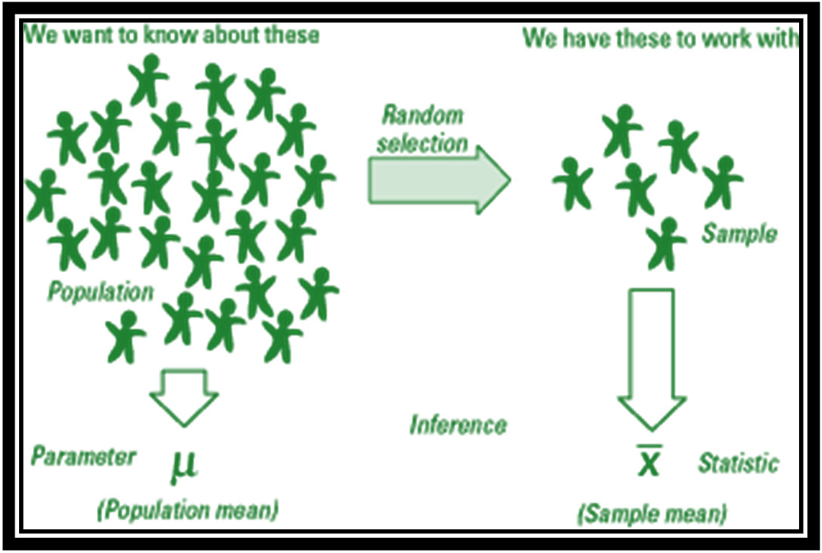
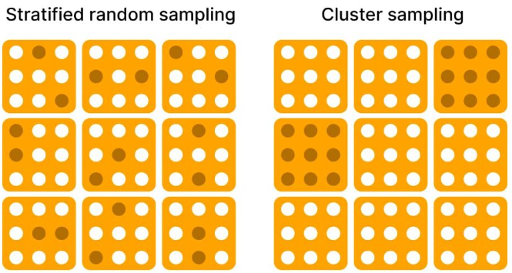
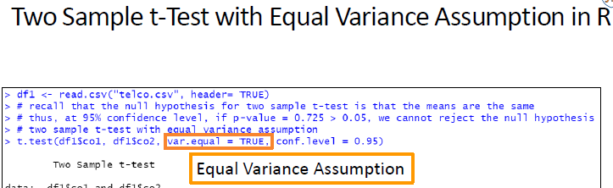
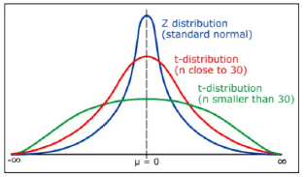
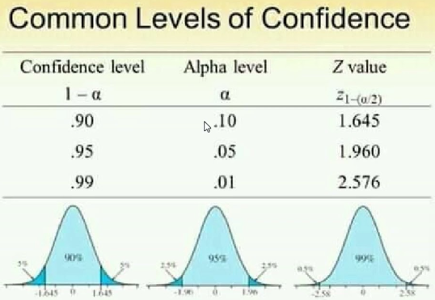
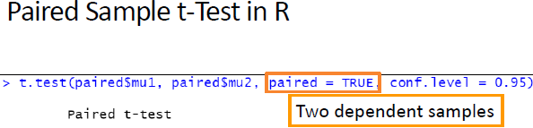










1. Statistic Bootcamp with R
Types of Sampling Technique
Categorical relate to Continuous
Simple Random Sampling
- Random sample from Pop
Systematic Sampling
- Line up Pop and select k^{th} individual for sample
Stratified Sampling
- Divide Pop into Strata and select individual from ea Strata for sample
Cluster Sampling
- Divide Pop into cluster and random select cluster for sample
 |  | Test | Conditions / Assumptions | Examples
1 Sample |  | Z test | Pop sd known
 |  | T test | Pop sd unknown
2 Sample |  | 2 Sample T test (2 independent groups) | Normality of Data in ea groups Homogeneity of Variance across groups (approx. equav var) Levene’s tests Independence of data points within ea groups
 |  | Paired T test (2 related/dependent groups)
>=3 Sample | 1 factor | 1 Way ANOVA | Normality of Data in ea groups Homogeneity of Variance across groups (approx. equav var) Independence of data points within ea groups | Golf ball distance by Groups A, B, C (1)
 | >=2 factors | 2 Way ANOVA |  | Golf ball distance by Groups A, B, C (1) By Golf ball sizes (2) By Golf ball price (3) …
If Pop sd unknown and sample size <30 -> t test
Else -> Z Test
Confidence Level – Level of confidence associated with estimate/result
Confidence Interval – Range of values of Sample data likely to contain true pop parameter with certain level of Confidence
Alpha α/Significance level – Prob threshold to define rejection region in hypo test
Z value/score – Standardized score on how many
Continuous relate to Continuous
 | Test | Conditions / Assumptions | Examples
SLR Simple Linear Regression | R² (Strong vs Weak, Positive vs Negative) Residual Analysis | Assumptions (LINE) Linear Relationship between y and x(s) Independently Identically distributed (iid) residuals / errors (randomly distributed and not related to ea other) Normally distributed residuals/errors Error/Residuals have constant variance Distribution of y is normally distributed | Study Time vs Exam scores
MLR Multi Linear Regression | Detect Multi-collinearity Correlation Matrix VIF – Variancesr Inflationary Factor (>5 = high correlated to other variable), x variables has to been independent of ea other |  | Study Time vs Exam scores vs Rest Time
Correlation test to see if correlation is significant
Residuals vs Fitted
Change x
QQ Plot (Normality)
Change y
Scale vs Location
Weighted least square regression
Residual Leverage (influential points)
Remove influential points
1 Sample Test of Proportion
Central Limiting Theorem
(Distribution) Sample size increase -> Approach Normal (Gaussian) Distribution
(Mean) Mean of sampling distribution of sample mean close to Mean of population/square root of sample size
(Standard Devation) SD of sample mean close to SD of pop
Shapiro test, H0 = Residuals normally distributed
Correlation Analysis
Create Linear Model
Important Checks***
Check Multi Collinearity (Correlation Matrix or VIF)
Check sig p value and adjusted R square
Residual Analysis (Shapiro Test if Residuals are Normally distributed, H0 = Normally Distributed)
Transformation (quadratic, exp, log etc)
Hypothesis Testing
Categorical relate to Categorical
Increasing the significance level (α) in hypothesis testing decreases the probability of Type 2 errors (false negatives) but increases the probability of Type 1 errors (false positives). This is because a higher significance level makes it easier to reject the null hypothesis, thus increasing the likelihood of mistakenly rejecting it when it is actually true.
On the other hand, decreasing the significance level (α) reduces the probability of Type 1 errors (false positives) but increases the probability of Type 2 errors (false negatives). This is because a lower significance level makes it harder to reject the null hypothesis, increasing the chance of failing to reject it when it is actually false.
Hot Encoding
Label Encoding
False Positive
False alarm
Incorrect accept H1
Incorrect reject H0
False Negative
Miss or overlook
Incorrect reject H1
Incorrect accept H0
N Hot Encoding
N-1 Hot Encoding
Male -> 0
Female -> 1
VIF – Variance Inflation Factor (only computed for numeric variable
SMART, Specific, Measureable, Achievable/Accurate, Relevant, Time-bound
Cost Function – Performance matrix, minimizing and maximising (optimization), minimize mean square error in LR
Apple -> [1, 0, 0]
Banana -> [0, 1, 0]
Orange -> [0, 0, 1]
Apple -> [1, 0]
Banana -> [0, 1]
Orange -> [0, 0]
Covid example
Business
Homoscedastic - homogeneity of variance constant across levels of predictor vairables

Slide 4
















Time Series Analysis Selection
Visual Inspection Increasing/Decreasing/Stationary
Autocorrelation & Partial Autocorrelation ACF and PACF
Diagnostic Checks
Business Requirements E.g. Forecast period
 | Univariate Forecasting Techniques/Methods | Description | Assumptions
Causal | Time Series Regression Ordinary Least Square (OLS) Regression | Linear, Quadratic or Polynomial trend | - Assume linear relationship between y and x variable - Independence of errors (no autocorrelation) - Homoscedasticity (constant variance of errors) - Normality of errors/residuals
Univariate | Dummy Variables Incorporating binary dummy variables (0 or 1) to account seasonal components | Seasonal time series | Stationarity: Assumes that the time series is stationary, which means that its statistical properties (mean, variance, autocorrelation) do not change over time
 | Decomposition Additive Decomposition for Constant Amplitude Multiplicative Decomposition for ∆ing Amplitude | Decompose Time series into Components Trend + Seasonal time series *Might force seasonal component when absent | Time series decomposition into multiple components (Trend, Seasonal, Cycle, Irregular) Components are either additive or multiplicative Seasonal component is fixed across all seasons
 | Smoothing Respond to recent data via weighted averages Reduce noise and emphasize underlying pattern Dampening Simple Averages (for stationary data) Moving Averages (higher n = greater smoothing effect) Exponential Smoothing (∆ing components over time) - Simple, Double (Holt) and Triple (Holt-Winter) | Exponential Smoothing (ES) - Greater weight for recent over remote observations - Dampening factor α Simple ES - Level Double ES – Level, Trend Triple ES - Level, Trend and Seasonal | - Errors are normal and independent (white noise) Greater weight for recent over remote observations
 | Box-Jenkins (ARIMA/SARIMA) For stationary time series*** For non-stationary, transformation to stationary via Differencing, Augmented Dickey-Fuller (ADF) < -3 | Autocorrelation (ACF) – statistical measure of observation correlation w itself over time lags Partial Autocorrelation (PACF) – ACF while accounting for the influence of observations within the lags in between | Stationarity - Assume time series made stationary after differencing Autoregressive AR(p) - relationship between current and past observations - Linear relationship between successive values - Y_{t} is a Stationary process - Errors are normal and independent (white noise) Moving Average MA(q) - relationship between current observation and past white noise (random) error terms - Current observation influenced by random fluctuations
Recommended for
Which Time Series Data
Clear trend and relationship
Seasonality, Special Holidays/Events
Time Series Component Description
Trend Increasing/Decreasing/Stationary
Cycle Presence/Absence
Seasonal (follow Calendar) Frequency – daily/monthly/quarterly Additive(constant Amplitude)/ Multiplicative(∆ Amplitude)
Irregular Fluctuations Random or Stochastic noise
Multiple Time Series Component
Short-Term Forecast
Trend Analysis
Lots of historical data w Trends and Season
Backshift Operator (B)
Notes:
Residual Analysis
Model Selection Criteria (AIC - Akaike Information Criterion, lower = better trade off between model-fit and complexity)

Slide 5












Predictive Modelling Techniques
- Linear Regression
- Logistic Regression
- Decision Tree
- Neural Network
Decision Tree
Overfitting – Model performs well w training data but unable to generalize unseen or new data, capturing both underlying patterns (good) and random fluctuations (bad) in data
- Pre-pruning (forward pruning), stop growing tree
- decrease accuracy on validation dataset
- Post-pruning, remove branches from fully grown tree
- More accurate than pre-pruning
- Long time
Goodness Function – choosing of splitting attribute
- Smallest tree
- Information Gain – purity of subset attributes produce
- Gini Index
- Chi-Square Test
Gini – Measurement of statistical dispersion
0 – Perfect purity (all elements in 1 category)
0.5 - Perfect impurity (all elements equally distributed across all categories)
Neural Network (NN) Model: Multiple Layer Perceptron (MLP)
- Weighted liner combination + Non-llinear function application (aka activation function)
- 3 layers of perceptron
- Input Layer
- Hidden Layer (>=1)
- Output Layer
- No. of trainable model parameters = No. of connection between layers
- e.g. 2 Input -> 1 hidden layer of 4 nodes/perceptron -> 1 Output
- (2+1)*4+(4+1)*1 = 14 connections (need to include bias connection as well)
Loss Function
- Quantify gap between prediction and ground truth
- Regression -> MSE (Mean Squared Error)
- Classification - > BCE (Binary Cross Entropy)
Backpropagation – Gradient Descent
- Fundamental algorithm for training NN
- Learning rate 𝛼, magnitude of adaptation model weight at ea iteration
Activation Function, introduce non-linearity and encourage model learning complex relationship and representations from input data
- e.g. ReLU, Sigmoid,
Overtraining
Bias Error – Difference between predicted and actual data points
Variance Error – High VE = overly complex and capture noise in training data
CNN (Convolutional Neural Network)

Slide 6


















Text Analytics (aka Text Mining)
- Derive insights, trends and patterns from unstructured text data
- Transform unstructured text -> structured numerical data
Text Categorization
- automatically assigning predefined categories or labels to textual documents based on content
Hard Classification – uniquely into 2 or more categories
Soft Classification – one or more categories per document
Text Data Pre-processing (Vectorization Methods)
- Tagging, selection/extraction of parts
- <DOC>, <SUBJECT>, <TOPIC> in XML
- Attribute-value pair in JSON
- Tokenization, splitting text into individual units (Tokens)
- Identifying token delimiters (space, tab, punctuations etc)
- Unigram, bigram, trigram models
- Case Lowering, case normalization
- Stemming/Lemmatization
- Inflectional Stemming, (Lemmatization), prefix/suffix removal
- Derivational Stemming, reduce to lexical/sematic root via affix removal
- Stopword removal (conjunctions, prepositions, pronouns etc)
- Punctuation removal
- Numeric removal
Generative Classifiers
Naïve Bayes Model
- Probabilistic approach
- probability of belonging to a specific class by considering the likelihood of its features given that class and the prior probability of the class itself
Text Clustering
- groups similar documents together based on their content, without predefined categories or labels
Single Value Decomposition (SVD)
Topic Modelling
Approaches to building IE System
Rule-based Systems
Hand code by Linguist (Domain input)
Iterative method
Slow but good results
Good for static corpus and well defined limited domains
Machine learning-based Systems
Start w well-annotated corpus
Derive Model depending on Method
HMM - based on previous word, uses observed data to infer the hidden states of a system
Transition Probability, probability of POS tag occurring given POS tag
Observation Likelihoods, probability of POS tag associated w word
CRF (Conditional Random Fields) - based on all previous words, probabilistic model used for structured prediction tasks, such as sequence labeling and image segmentation
SVM - classification and regression tasks, which finds the best hyperplane that separates the data into different classes
Language independent, no linguistic or domain knowledge
Dependent on how well corpus is annotated
Large training sample to get good results
Table of POS (Part-Of-Speech) Tags
Discriminative Classifiers
Decision Tree Classifiers
- Information gain
Rocchio Classifiers
- profile vector
Support Vector Machines
- divide term space in hyperplanes
- widest separation is selected as classifers
How IE System works
Identify nouns, names, NEs
Aggregate contiguous/adjacent Nes/Nouns./Names
Lexical and Syntactic Markup
Main components of IE System
Tokenization
Convert text into small units (Tokens)
2. POS tagging (Morphological & Lexical Analysis)
Sequence labelling via sequence model/classifier
Rule-based - Brill
based on dictionary and morphological rules
Stochastic - CLAWS, Viterbi, Baum-Welch
based on HMM (Hidden Markov Models) and ngram probabilities distribution over possible sequences of labels (HMM decoding)
3. Shallow Parsing/Chunking (Syntactic Analysis)
Identify meaningful phrases/chunks in sentence
Full Parsing/Parsing/Tree
Produce full parse of sentence with syntactic functions of each word
More info and more expensive than Shallow Parsing
4. Co-reference Resolution
Identify relation
Whole-part relation
Determinant Entities (Pronouns)
Definite Descriptions
TDM – term-document matrix
- Binary (Present/Absent)
- Frequency-based
- Global Frequency, no. of times term appears in corpora
- Document Frequency, no. of docs contain term
- Wordcloud
Information Retrieval
Process of querying/retrieval of query results
Information Extraction (IE)
Process of automatic identification and extraction of structured information from query ornatural language documents
Information can be drilled down into
Entity/Concept/Named Entities (NEs)
Identified via Named Entity Recognition (person, organization, location, money, date, time & percentages)
Turn verbose text data into more compact structural form
Attribute
Property of an entity (name, height, type)
Fact/Relationship
Identified via Relation Extraction (child-of, parent-of, staff-of)
Predicate about an entity
Relationship between 2 entities
Expressed as RDF (Resource Description Framework) triple
Subject(entity)-predicate(relation)-object(entity)
Event
Identified via Event Extraction
Events which entities participate, temporal expressions
Domain/task specific, usually verbs
Evaluating/Comparing Classfiers
- Add semantics
- Add cost function
- Essentially wrt business context
Normalised Frequency
tf-idf (Inverse Document Frequency)
- word appear in many documents -> unimportant
- word is unique and appears in few documents -> important
Word Embedding - individual words as vectors
- Words with similar meanings or contexts are represented as vectors that are closer together in this high-dimensional space
- Word2Vec and GloVe
- e.g. "King" - "Man" + "Woman" results in a vector close to "Queen."
Document Embedding – entire documents
- capture overall context and semantics
- Doc2Vec
- eg, Two similar reviews about a movie may have document embeddings that are close in the vector space.
Contextual Embedding - surrounding context of a word within a sentence
- more context-aware representations compared to traditional word embeddings
- ELMo
- e.g. bat (flying mammal or sports equipment), table (furniture or dataframe)
Terminology
Corpus – single collection of text eg. Text Document (Corpora is plural)
Syntax – set of rules/principles govern arrangement and structure of words/phrases to create sentence/expression in language

